Slide 1
Supply Chain
Backorder Prediction
Manichandra Majji
Madhulika Sable
Maneesh Reddy

Slide 2
Overview
Introduction
Workflow
Results
Future scope

Slide 3
Introduction
Backorder is an order which can’t be fulfilled at the given time due to lack of supply or the product is currently out of stock or not in inventory.
This occurs when demand exceeds supply or due to poor inventory management.
Backorders can lead to customer dissatisfaction, disrupt the supply chain and eventually incur losses.

Slide 4
Introduction cont.
What is the need for having a backorder prediction system?
Increasing safety stock to meet demands is not a financially viable solution.
Predicting what products could go into backorder ahead of time will help companies optimize their planning to avoid potential burden on production, logistics and transportation planning.
Enterprise resource planning (ERP) systems can provide historical data that can be used to identify patterns and develop a predictive model to forecast potential backorders and plan accordingly.

Slide 5
Dataset
The dataset has been collected from Kaggle.
The dataset contains historical data on inventory, supply chain, and sales operations data.
It contains approximately 1.9 million rows and 23 features.
The target variable is a binary variable, with "Yes" indicating that the product is likely to go into backorder and "No" indicating that the product is not likely to go into backorder.

Slide 6
Workflow
Problem Identification
Develop a binary classification model that leverages data from an Enterprise Resource Planning (ERP) system to classify whether a product is likely to go into backorder or not ahead in time.
Establish Metrics
Data Exploration
Data Cleaning
Feature Engineering
Modelling

Slide 7
Workflow
Problem Identification
Establish Metrics
Aim is to reduce both false positives and false negatives. So, F-1 score is chosen as the preferred performance metric along with accuracy.
Data Exploration
Data Cleaning
Feature Engineering
Modelling

Slide 8
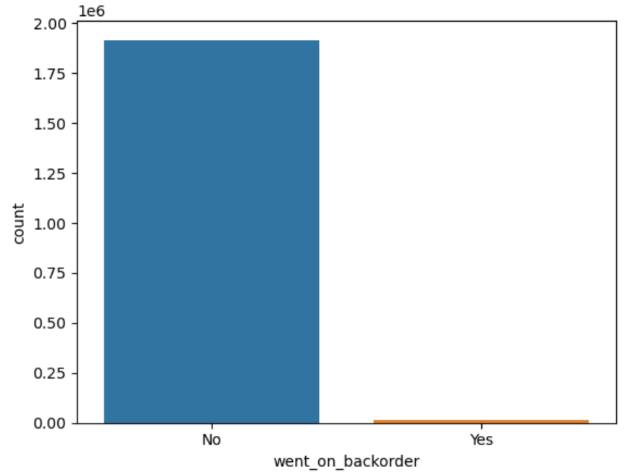
Workflow
Class imbalance (1:137)
Few features are right-skewed
Existence of redundant features
Problem Identification
Establish Metrics
Data Exploration
Data Cleaning
Feature Engineering
Modelling

Slide 9
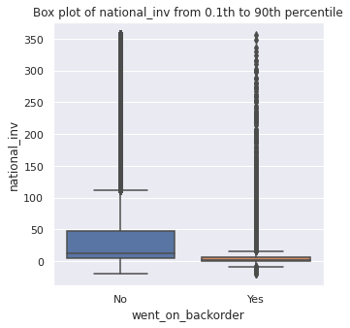
Workflow
Problem Identification
Establish Metrics
Data Exploration
Data Cleaning
Feature Engineering
Modelling

Slide 10
Workflow
Problem Identification
Missing values - Mean imputation
Corrected incorrect values
Eliminate outliers
Univariate
Multivariate - Mahalanobis Distance
Dropping redundant features
Establish Metrics
Data Exploration
Data Cleaning
Feature Engineering
Modelling

Slide 11
Workflow
Problem Identification
Establish Metrics
Log transformation for right-skewed features
One-hot encoding categorical features
Standardizing data
Data Exploration
Data Cleaning
Feature Engineering
Modelling

Slide 12
Workflow
Oversampling using SMOTE to address class imbalance
Random sampling to address training issue
Models Used:
Logistic Regression
Decision Tree
Random Forest
XGBoost
Custom Ensemble
Problem Identification
Establish Metrics
Data Exploration
Data Cleaning
Feature Engineering
Modelling

Slide 13
Results
Model | Train Accuracy | Test Accuracy | F-1 Score
Logistic Regression | 0.830 | 0.839 | 0.662
Decision Tree | 0.983 | 0.924 | 0.753
Random Forest | 0.997 | 0.953 | 0.826
XGBoost | 0.973 | 0.944 | 0.787
Ensemble | 0.986 | 0.941 | 0.787

Slide 14
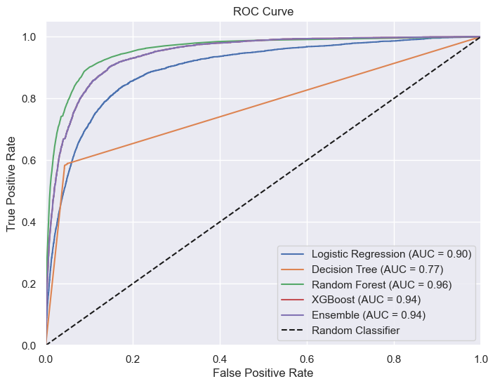
Results

Slide 15
Future scope
Perform modelling without oversampling and compare the results with those obtained with oversampling.
Fit a regression model to identify the weights for the custom ensemble.

